Slide 1
Power BI
parkrun Report
(a retail analogue)
Ross Waterston - Director
Geordie Intelligence Limited
Clavering House
Clavering Place
Newcastle upon Tyne
NE1 3NG

Slide 2


Who am I?
Ross Waterston
20+ years of experience
15+ years process design
9+ years Power BI
5+ years Power Apps
5+ years Power Automate
Founded Geordie Consulting (2020) to be an Analytics Centre of Excellence in the North-east. Business data analysis must focus on business outcomes rather than just the numbers. Meaning is everything.
Founded Geordie Intelligence (2020) to empower everyone to be more data literate and able to work with and understand the relevance/meaning of data.

Slide 3
BI the Microsoft way
Data Model (DAX)
Analyse/use
Power BI
Data
SQL
Excel
Power Platform
Etc..
Excel online
Excel
Curate (M Script)
Dataflows
Azure
Microsoft Fabric
Power BI
SharePoint
Microsoft Fabric

Slide 4
Summary
The first project many organisations undertake in Power BI is typically related to the automation of a manual daily report.
Almost every organisation has at least one instance of this, a daily summary or report is sent out by someone. This report takes them up to half an hour to produce each day.
parkrun is a free weekly timed 5km event, these weekly events take place at 1000+ locations globally.

Slide 5
Our plan
Power Automate Desktop
Read Source
Save spreadsheets
Dataflows
Combine spreadsheets
One Dataflow per Location
Semantic Model
Combine Dataflows
One SharePoint folder per Location
Visualisations
Report
Metrics
Dashboard

Slide 6
SharePoint List - Control
Records are used to facilitate
data extract
Map location
Local Authority comparison
Dataflow Refresh
Semantic Model Refresh
SharePoint List controls the whole ETL process
Each Location has a record
Name
Map Coordinates
Local Authority
Dataflow GUID
Online customer tables that can be configured to use Power Apps to manage content. Automation can also use the table as required.

Slide 7
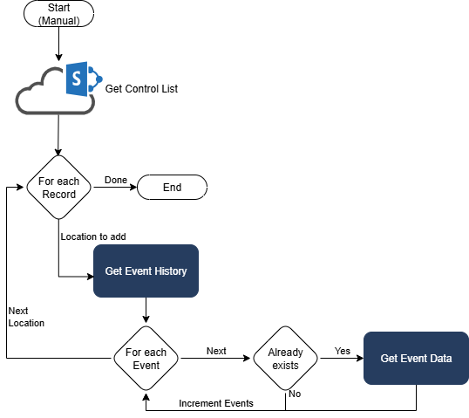
Power Automate Desktop
Script
Reads the SharePoint List
Function – Event History
Connect to Event History and build full list of events for a location
For Each Row of List processes the records
Function – Event Data
Connect to a specific event and capture a spreadsheet for participants and Volunteers.

Slide 8
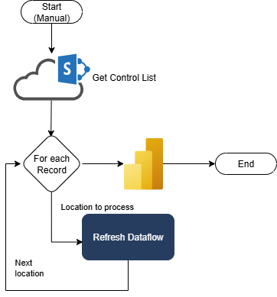
Power Automate Service
Script
Loop
Connect to the SharePoint List and for each row (location) process
Use GUID to trigger Dataflow refresh
Refresh Semantic Model
Refresh Power BI Semantic Model – this will refresh all reports and Metrics

Slide 9
parkrun Report
This is a standard development path that is seen in the presence of a Centre of Excellence. A simple initial request of “Can we replicate a simple daily report?” the objection is often to save time and maybe reduce the workload of a specific person.
Automation then leads to the ability to expand and provide additional value. This richer data value expands the value provided
Expansion becomes iterative and the data value provided changes. V1 was limited value, V2 is really only of interest to those who know Jesmond Dene parkrun, V3 and V4 serve real Public Health value far beyond that initial expected value.
V1 – Lost
Single Event of Jesmond Dene parkrun
V2 – Click to view
All events held at Jesmond Dene parkrun
V3 – Click to view
All events held in Newcastle upon Tyne
V4 – Click to view
All events held in Northumberland, Newcastle, North Tyneside, Gateshead, South Tyneside and Sunderland
https://www.youtube.com/@GeordieIntelligence

Slide 10
Demo
North East parkrun Report – a quick overview

Slide 11
Metrics
KPI’s managed and maintained in the service

Slide 12
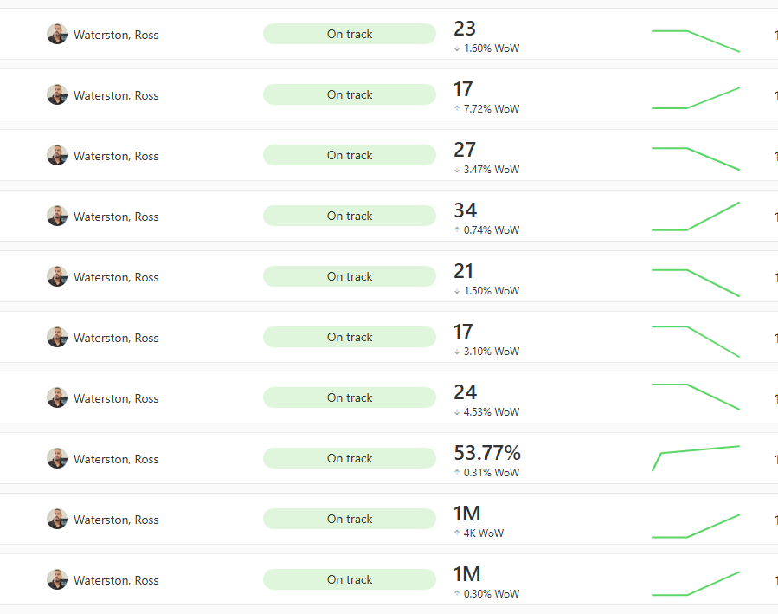
Metrics
KPI’s that automatically track and expand
Updated when Dataset refreshes
Automatic status Evaluation
Changes can trigger actions
Integration into Teams for communication and ease of use

Slide 13
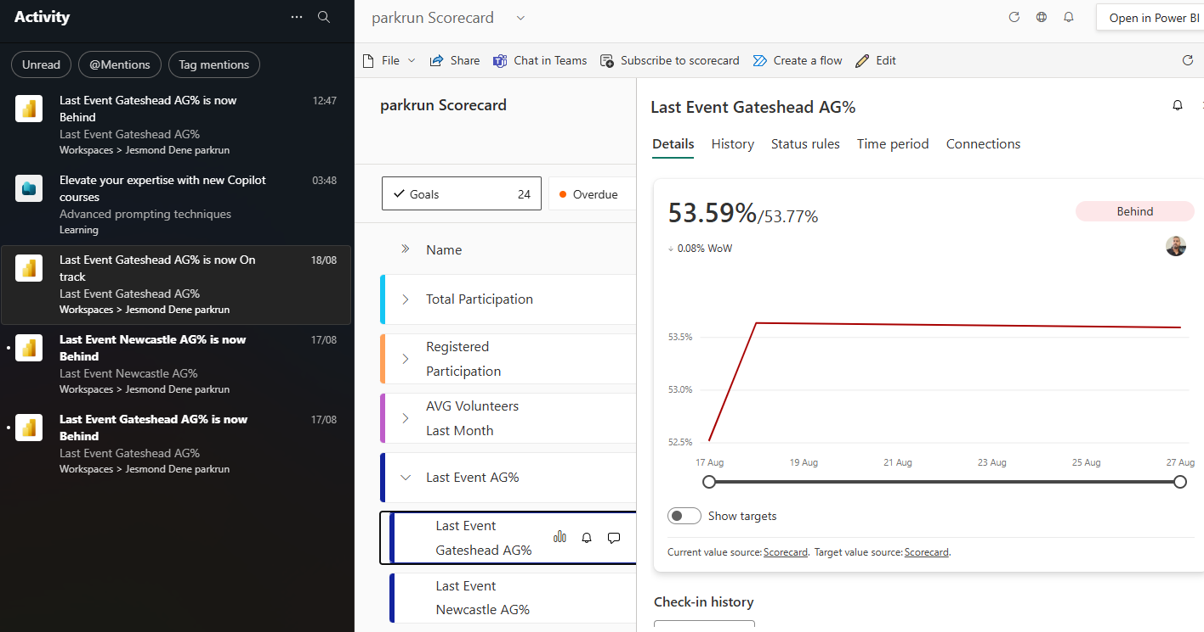
Metrics in Teams

Slide 14
Demo 2
Metrics and how to manage them

Slide 15
Ross Waterston
Director
https://www.linkedin.com/in/rosswaterston/

